Slide 1
COMPUTER ARCHITECTURE
Lesson 2
This lesson might take a week or two to complete
Dr. John P. Abraham, Professor
UTRGV
Prof. John P. Abraham, UTRGV

Slide 2
Structure of 8088 Microprocessor
Early microcomputer chip had two main parts
  execution unit (EU)
  the bus interface unit (BIU)
Prof. John P. Abraham, UTRGV

Slide 3
Execution Unit (EU)
the control logic for decoding and executing instructions
ALU for performing arithmetic and logic operations
A set of general purpose registers
Prof. John P. Abraham, UTRGV

Slide 4
Bus interface unit (BIU)
A bus is a set of wires that connects the various components of a computer together and transfers signals and data between them.
The number of lines a bus has depends on the architecture of the microprocessor and is directly proportional to the CPU speed.
  Control
  Data
  Address
Prof. John P. Abraham, UTRGV

Slide 5
3 Functions of the BUS
memory address transfers, data transfers and control signal transfers.
One set of physical wires may handle all three operations one at a time, or there may be different sets of wires for each, the address bus, data bus and the control bus.
If we say that the hypothetical processor is 16 bit, then 16 bits of data should be transferred at the same time.
Prof. John P. Abraham, UTRGV

Slide 6
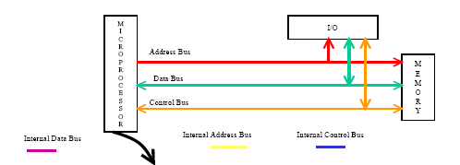
Prof. John P. Abraham, UTRGV

Slide 7
Major microprocessor components
PC- Program Counter
MBR- Memory Buffer Register
MAR- Memory Address Register
ALU- Arithmetic Logic Unit
IR- Instruction Register
General Purpose Registers.
Prof. John P. Abraham, UTRGV

Slide 8
■■ From your textbook:
Memory buffer register (MBR): Contains a word to be stored in memory or sent to the I/O unit, or is used to receive a word from memory or from the I/O unit.
■■ Memory address register (MAR): Specifies the address in memory of the word to be written from or read into the MBR.
■■ Instruction register (IR): Contains the 8-bit opcode instruction being executed.
Prof. John P. Abraham, UTRGV

Slide 9
■■ Instruction buffer register (IBR): Employed to hold temporarily the right-hand instruction from a word in memory.
■■ Program counter (PC): Contains the address of the next instruction pair to be fetched from memory.
■■ Accumulator (AC) and multiplier quotient (MQ): Employed to hold temporarily operands and results of ALU operations. For example, the result
Prof. John P. Abraham, UTRGV

Slide 10
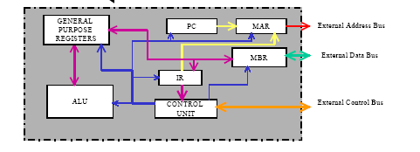
Prof. John P. Abraham, UTRGV

Slide 11
Microprocessor operation
When a program begins execution, the program counter (PC, a register inside the CPU) has the address of the next instruction to fetch.
this address is placed there initially by the operating system and updated automatically by the CPU.
There are three additional registers, the instruction register (IR), memory address register (MAR) and the memory buffer register (MBR) that work together to fetch the instruction.
Prof. John P. Abraham, UTRGV

Slide 12
Microprocessor Operation (2)
The address from the PC is moved to the MAR.
  The reason for this is that the address bus is connected to the MAR and all addresses issued must go through this register.
Then the address contained in the MAR is placed on the address bus and the READ line is asserted on the control bus.
Prof. John P. Abraham, UTRGV

Slide 13
Microprocessor Operation(3)
The memory whose address is found on the address bus places its contents on the data bus.
The only register that is connected to the data bus is the MBR, and all data should go in an out through this register.
Thus the data on the data bus is copied into the MBR. The instruction is now copied on to the IR to free up the MBR to handle another transfer.
Prof. John P. Abraham, UTRGV

Slide 14
Microprocessor Operation(4)
The contents of the PC will be now incremented by one instruction.
The instruction is then decoded and executed.
In practice, more than one instruction is read during an instruction cycle. Additional instructions are kept in temporary storage registers such as the Instruction Buffer Register (IBR).
Prof. John P. Abraham, UTRGV

Slide 15
The Program Counter
The size of the PC depends on the number of address lines of the CPU.
Let us assume that the CPU has 16 address lines. Then the PC should be able to address 65,536 locations.
Initially the CPU starts its operation based on the contents of the PC. Assume that initially the PC contains the value 0000h where “h” stands for hexadecimal notation.
Prof. John P. Abraham, UTRGV

Slide 16
The Fetch Cycle
MAR holds the address of the memory location from which the instruction is to be fetched.
At the start up, the CPU performs an instruction fetch.
Instruction fetch involves reading the instruction stored in the memory.
The location from which the instruction is read is derived from the PC.
Prof. John P. Abraham, UTRGV

Slide 17
The Decode Cycle
An instruction will have an opcode and none, one or more operands (data to operate on)
The opcode is defined as the type of operation the CPU has to perform.
The number of bits assigned to the opcode will determine the maximum number of instructions that processor is allowed to have.
Prof. John P. Abraham, UTRGV

Slide 18
Opcode
suppose that the length of an instruction (opcode and operand) is 16 bits, 4 bits are allocated for the instructions and the remaining 12 bits are allocated for an operand.
Four bits can give us a maximum of sixteen instructions. Each of these 16 bit patterns, ranging from decimal 0 to 15, or binary 0 to 1111, or hexadecimal 0 to F will stand for a particular instruction.
Prof. John P. Abraham, UTRGV

Slide 19
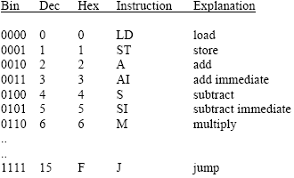
Instruction set of an imaginary computer
Prof. John P. Abraham, UTRGV

Slide 20
Other useful instructions
ORG Where to start the program.
      This location will be moved to PC initially.
READ Read will read from the keyboard.
      and put the value in the AC.
PRINT - contents of PC will be placed on video memory.
END - end of the program
Prof. John P. Abraham, UTRGV

Slide 21
Operations of a Microprocessor
This hypothetical computer has only one user addressable register, which is the accumulator (AC).
When a load (LD) is executed, the contents of the location as indicated by the operand is brought into the AC
The reverse happens in a store (ST).
Prof. John P. Abraham, UTRGV

Slide 22
Operations of a Microprocessor(2)
When an add (A) is executed, the value contained in the memory location as indicated by the operand is added to the contents of the AC, and the result is placed back in the AC.
The add immediate (AI) differs from the add (A) in that the operand is what is added, not the content of the memory pointed by the operand.
Prof. John P. Abraham, UTRGV

Slide 23
Program Example
B = B + A
C = B + 2
The variable A is kept in memory location 200h
Variable B in 201h
Variable C in 202h.
The values in each are 5, 3 and 0 respectively.
Prof. John P. Abraham, UTRGV

Slide 24
Program Example (2)
There are three registers that need watching, the Accumulator (AC), Program Counter (PC), and the Instruction Register (IR).
The PC contains 100h, which means that the next instruction should be fetched from memory location 100 hexadecimal.
Prof. John P. Abraham, UTRGV

Slide 25
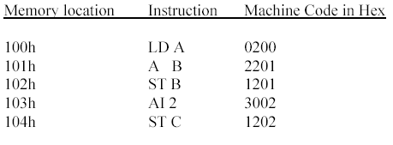
Program Example (3) – The code
Prof. John P. Abraham, UTRGV

Slide 26
Program Example (4)
The control unit fetches the instruction contained in the address indicated by the PC, which is 100h.
The instruction 0200 is brought into the IR.
The IR now contains 0200. The instruction is decoded and separated in opcode of 0 and operand of 200. This is based on the assumption that 4 bits (one hexadecimal digit) are used for the opcode and 12 bits (three hexadecimal digits) are used for the operand.
Prof. John P. Abraham, UTRGV

Slide 27
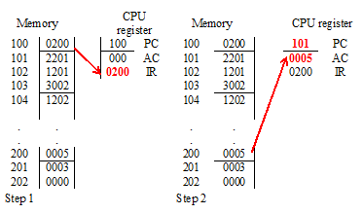
Prof. John P. Abraham, UTRGV

Slide 28
Program Example (5)
Once the instruction is fetched the PC is automatically incremented, and now contains 101h.
The opcode 0 indicates a load, and the operand is fetched from memory location 200h and loaded into the accumulator (AC).
Now the accumulator contains 5.
Prof. John P. Abraham, UTRGV

Slide 29
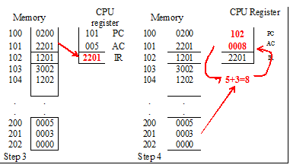
Prof. John P. Abraham, UTRGV

Slide 30
Program Example (6)
The instruction from 101h is fetched and placed in the IR.
The PC is incremented to 102h.
The content of IR is decoded and based on the opcode of 2, the operand located in address 201h is added to the AC.
The AC now has a value of 8.
Prof. John P. Abraham, UTRGV

Slide 31
Program Example (7)
The next instruction whose address is contained in the PC is fetched and placed in the IR giving it a value of 1201.
The PC is incremented to 103h.
The contents of IR (1201) is decoded and based on the opcode of 1, the contents of the AC is saved in the address indicated by the operand, which is 201h.
Address 201 (variable B) now has a value of 8.
Prof. John P. Abraham, UTRGV

Slide 32
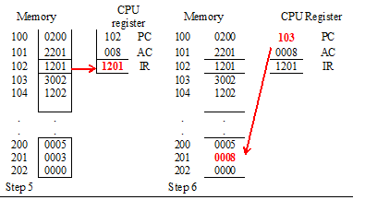
Prof. John P. Abraham, UTRGV

Slide 33
Program Example (8)
The instruction contained in 103h (PC content) is fetched next and placed in the IR giving it a value of 3002.
The PC is incremented to 104h The contents of IR is decoded, and based on the opcode of 3 it is an add immediate.
No data fetching is necessary and the 2 is added to the AC.
The new value of the accumulator is now 10.
Prof. John P. Abraham, UTRGV

Slide 34
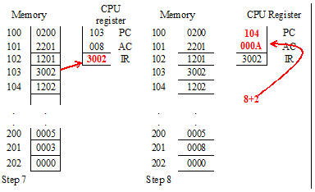
Prof. John P. Abraham, UTRGV

Slide 35
Program Example (9)
The last instruction is now fetched and placed in IR.
The PC is incremented to 105h.
The PC now contains 1202, and it is decoded to give the opcode of 1 and operand of 202.
Since hex 1 is a store, the value of AC (the value is 10) is stored in memory location 202h.
It was already mentioned that 202h is the memory location assigned to C.
Prof. John P. Abraham, UTRGV

Slide 36
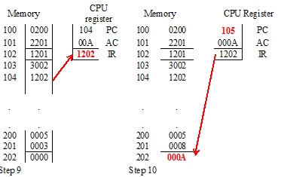
Prof. John P. Abraham, UTRGV

Slide 37
MARIE SIMULATOR
https://www.youtube.com/watch?v=OqzNWznukJA
Fixed word length of 16 bits for both data and instructions
Addressable memory is 2^12 or 4K (4096 bytes)
Instructions has 2 fields, opcode 4 bits an 12 bits operand
ALU is 16 bit wide
Has 7 registers for control and data movement
Prof. John P. Abraham, UTRGV

Slide 38
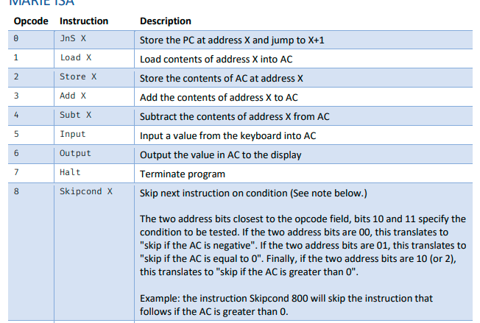
Prof. John P. Abraham, UTRGV

Slide 39
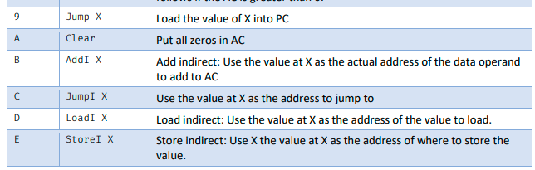
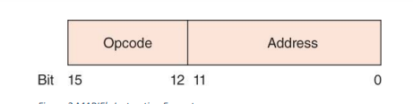
Prof. John P. Abraham, UTRGV

Slide 40
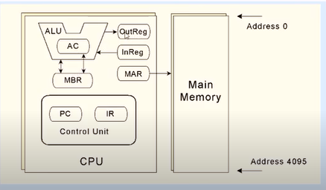
Registers of MARIE
AC, MAR, MBR, IR, inR, OutR, (these two hold input and output)
Prof. John P. Abraham, UTRGV

Slide 41






MARIE FIRST PROGRAM
When we launch the MARIE assembler all registers contain 0 and input and output are blank. Also all RAM locations 0h to 1000h all contain 0.
Write your program in File edit.
You need to tell MARIE where to put your first instruction. This is the address that will be placed in the PC. The instruction is ORG (origin) and the address, like this: ORG 1000
ORG 100
LOAD X
ADD Y
STORE Z
HALT
X, Dec 35
Y, Dec -23
Z, Dec 0
This is program one.mas
Save and Assemble
Now load the assembled one.mex. Watch PC=100
Now you will see opcode and operands, and machine code in hex. 1 is to load, and 104 is the address where X is kept
Prof. John P. Abraham, UTRGV

Slide 42
Subtract Program
ORG 100
LOAD num1
SUBT num2
STORE ans
HALT
num1, Dec 10
num2, Dec 8
ans, Dec 0
Prof. John P. Abraham, UTRGV

Slide 43
MARIE B=B+A, C=C+2 PROGRAM
YOU ARE GIVEN THIS ASSIGNMENT TO WRITE AN ASSEMBLY PROGRAM IN MARIE.
Please make a note of the registers and the RAM as you step through the lines.
Please take a note of the symbol map created for the variables.
Use input to place a value in AC you can STORE IT from the AC.
Prof. John P. Abraham, UTRGV

Slide 44
Input and output
/DEMO INPUT AND OUTPUT
ORG 200
INPUT
STORE A
OUTPUT
INPUT
STORE B
OUTPUT
HALT
A, Dec 0
B, Dec 0
Prof. John P. Abraham, UTRGV

Slide 45
STOP THIS LECTURE HERE.
WE WILL CONTINUE THE REST OF IT IN THE NEXT POWER POINT LESSON.
Prof. John P. Abraham, UTRGV

Slide 46
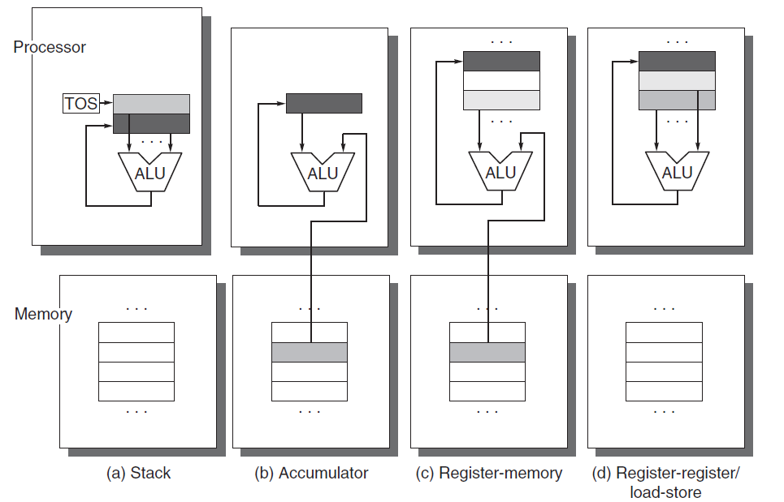
3 types
stack, an accumulator, or a set of registers. Operands may be named explicitly or implicitly. C = A + B shown below. Lighter shades indicate inputs, and the dark shade indicates the result.
Prof. John P. Abraham, UTRGV
Notes:
Figure A.1 Operand locations for four instruction set architecture classes. The arrows indicate whether the operand
is an input or the result of the arithmetic-logical unit (ALU) operation, or both an input and result. Lighter shades
indicate inputs, and the dark shade indicates the result. In (a), a Top Of Stack register (TOS) points to the top input
operand, which is combined with the operand below. The first operand is removed from the stack, the result takes
the place of the second operand, and TOS is updated to point to the result. All operands are implicit. In (b), the Accumulator
is both an implicit input operand and a result. In (c), one input operand is a register, one is in memory, and
the result goes to a register. All operands are registers in (d) and, like the stack architecture, can be transferred to
memory only via separate instructions: push or pop for (a) and load or store for (d).
Stack Accumulator

Slide 47
INSTRUCTION SET
Lecture on instruction set can be given here or at the end of this slide set.
Instruction set
Prof. John P. Abraham, UTRGV

Slide 48
Hennessy and Patterson– Fundamentals of Quantitative Design and Analysis
  70 years of computer technology
  25% performance improvement/year for first 25yrs
  Dramatic dominance of microcomputers since late 70s – 35% improvements/year. After 2003 less than 22% per year attributed to singe cpu.
  Renaissance computer design
    Architectural innovation
    Efficient use of technology improvements
    Vendor-independent operating system such as unix
    Paved way to RISC machines
Prof. John P. Abraham, UTRGV
Notes:
1988 cray y-mp, the fastest machine is very similar to a workstation of today for fraction of the cost.

Slide 49
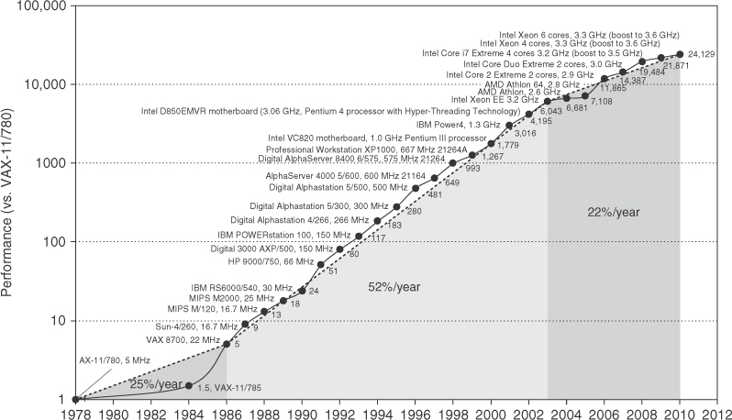
Growth in processor performance since late 70s
Prof. John P. Abraham, UTRGV

Slide 50
Growth in processor performance since the late 1970s. This chart plots performance relative to the VAX 11/780 as measured by the SPEC benchmarks (see Section 1.8). Prior to the mid-1980s, processor performance growth was largely technology driven and averaged about 25% per year. The increase in growth to about 52% since then is attributable to more advanced architectural and organizational ideas. By 2003, this growth led to a difference in performance of about a factor of 25 versus if we had continued at the 25% rate. Performance for floating-point-oriented calculations has increased even faster. Since 2003, the limits of power and available instruction-level parallelism have slowed uniprocessor performance, to no more than 22% per year, or about 5 times slower than had we continued at 52% per year. (The fastest SPEC performance since 2007 has had automatic parallelization turned on with increasing number of cores per chip each year, so uniprocessor speed is harder to gauge. These results are limited to single-socket systems to reduce the impact of automatic parallelization.) Figure 1.11 on page 24 shows the improvement in clock rates for these same three eras. Since SPEC has changed over the years, performance of newer machines is estimated by a scaling factor that relates the performance for two different versions of SPEC (e.g., SPEC89, SPEC92, SPEC95, SPEC2000, and SPEC2006).
Prof. John P. Abraham, UTRGV

Slide 51
Class of computers
Mobile device <$1000
Desktop <$2,500
Server <10,000,000
Cluster <200,000,000
Embedded <$100,000
Prof. John P. Abraham, UTRGV

Slide 52
Critical system design issues
Cost, energy, media performance, responsiveness – FOR MOBILE DEVICES
Price performance, energy,graphics performance – FOR DESKTOPS
Throughput, availability, scalability, energy – FOR SERVERS
Price-performance, throughput, energy, proportionality – FOR CLUSTERS
Price, energy, application-specific performance for EMBEDDED
Prof. John P. Abraham, UTRGV

Slide 53
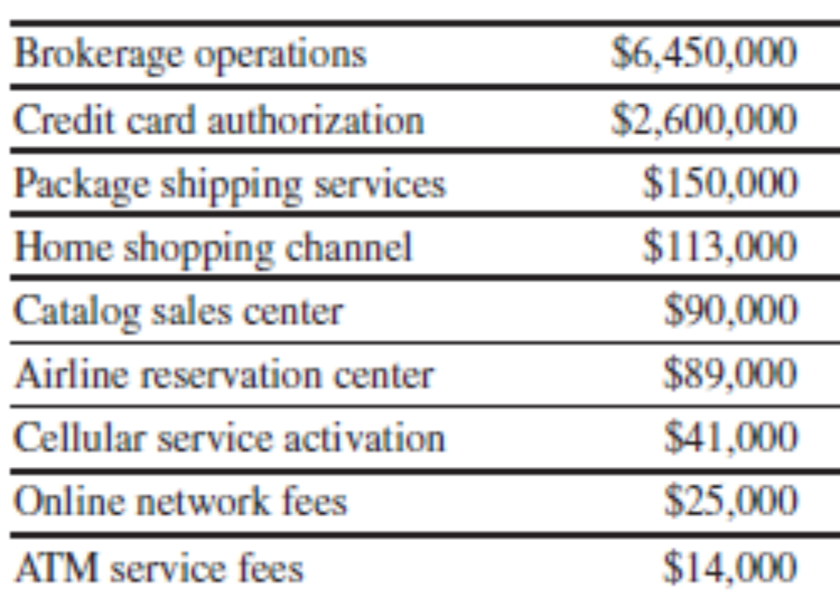
hourly losses with downtime
Prof. John P. Abraham, UTRGV

Slide 54
Parallelism
1. Data-Level Parallelism (DLP) arises because there are many data items that can be operated on at the same time.
2. Task-Level Parallelism (TLP) arises because tasks of work are created that can operate independently and largely in parallel.
Flynn classification of implemation
SISD, SIMD, MISD, MIMD (multiple instruction streams, multiple data streams)
Prof. John P. Abraham, UTRGV
Notes:
Computer hardware in turn can exploit these two kinds of application parallelism
in four major ways:
1. Instruction-Level Parallelism exploits data-level parallelism at modest levels
with compiler help using ideas like pipelining and at medium levels using
ideas like speculative execution.
2. Vector Architectures and Graphic Processor Units (GPUs) exploit data-level
parallelism by applying a single instruction to a collection of data in parallel.
3. Thread-Level Parallelism exploits either data-level parallelism or task-level
parallelism in a tightly coupled hardware model that allows for interaction
among parallel threads.
4. Request-Level Parallelism exploits parallelism among largely decoupled
tasks specified by the programmer or the operating system.

Slide 55
Our task as computer architects
Determine what attributes are important
Maximize performance without increasing cost
In fact, the cost has decreased dramatically.
Different aspects of the task
  Instruction set design
  Functional organization
  Logic design
  Implementation
Prof. John P. Abraham, UTRGV

Slide 56
Instruction Set Architecture - ISA
Programmer visible instruction set
Boundary between software and hardware
  General-purpose register ISA (we saw accumulator)
  Operands are registers or memory locations
  32 GP & 32 FP registers today
  Memory-byte addressable, read as a word. Can use byte, half-word or full word (32bits)
Prof. John P. Abraham, UTRGV

Slide 57
Addressing modes
Register
Immediate for constants
Displacement – constant offset is added to register to form a memory address (or 2 registers base register and displacement)
Prof. John P. Abraham, UTRGV

Slide 58
Operations
Data transfer
Arithmetic logical
Control
Floating point single (32 bit) or double precision (64bit)
Summarized page 13, fig 1.5
Prof. John P. Abraham, UTRGV

Slide 59
Control flow explained
Conditional branches
Unconditional jumps
Procedure calls
and returns
PC relative addressing for branching (PC + addressfield)
Prof. John P. Abraham, UTRGV

Slide 60
Implementation
Three aspects: ISA, Organization, Hardware
Organization (microarchitecture)
  High level aspects of a computer’s design: memory system, interconnect and design of CPU (core)
  Example: Intel vs AMD same instruction set but different organization
Hardware
  Logic design, etc.
Prof. John P. Abraham, UTRGV

Slide 61
Architecture can be driven by market
Widely accepted application software
  Architects will attempt to deliver speed to such software.
Well accepted compilers
  Architects may keep the same ISA
Price, power, performance & availability
Prof. John P. Abraham, UTRGV

Slide 62
Choice between designs
Design complexity
  Complex design takes longer to complete
  This will prolong time to market
  Someone may come up with a better machine meantime.
Cost
  A balancing act.
Prof. John P. Abraham, UTRGV

Slide 63
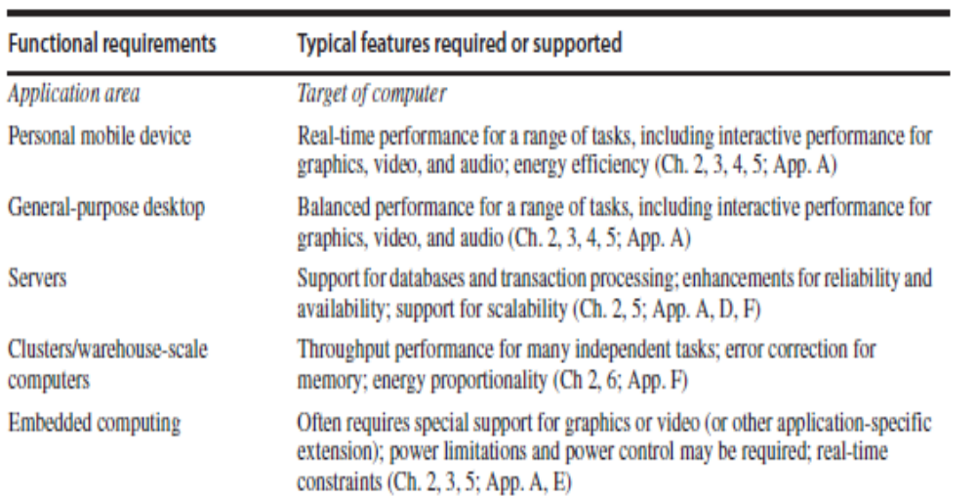
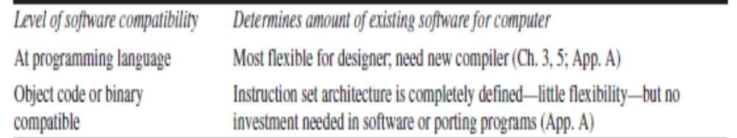
Requirements and features
Prof. John P. Abraham, UTRGV

Slide 64
Trends in technology and usage -1
IC logic technology: transistor density increases about 35% per year, ICs on a chip doubles every 18-24 months. Moore’s law.
DRAM capacity doubles every 2 -3 years.
Capacity of Flash memory increases 50-60%/year.
Magnetic disk technology improved
  300 to 500 times cheaper per bit than DRAM.
Prof. John P. Abraham, UTRGV

Slide 65
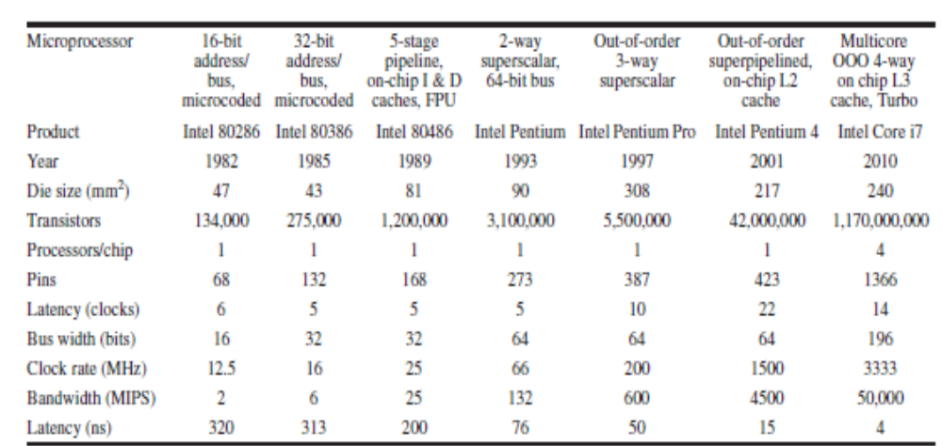
Performance milestones
Prof. John P. Abraham, UTRGV

Slide 66

Trends in Cost
Time, volume and commoditization
  Cost of manufacture decreases over time.
  Cost of Integrated circuit=(cost of die+cost of testing+cost of packing)/final yield
  Cost of die=cost of wafer/(dies per wafer x die yield)
  Dies per wafer=area of wafer/area of the die minus unusable wafer area at the edges. See figure 1.15
Prof. John P. Abraham, UTRGV

Slide 67
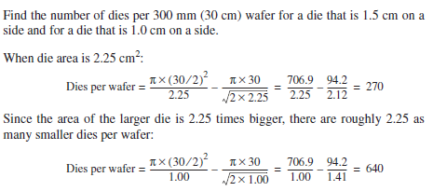
Example
Prof. John P. Abraham, UTRGV

Slide 68
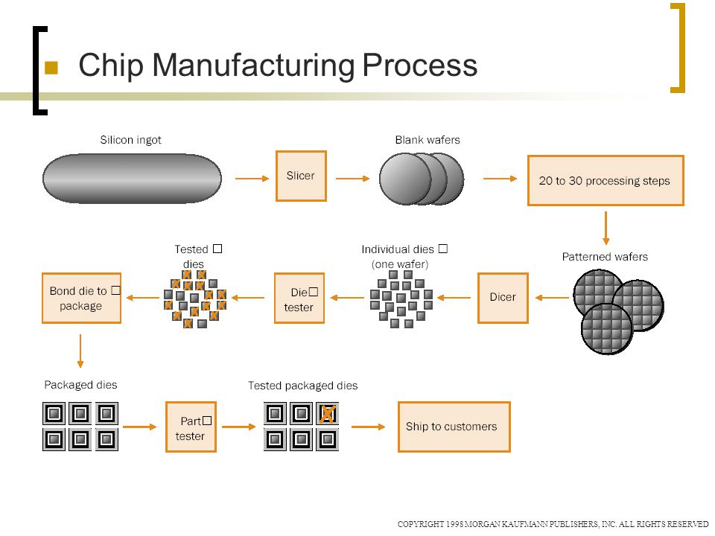
Prof. John P. Abraham, UTRGV

Slide 69
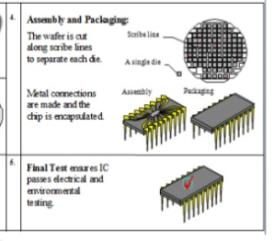
A manufacturing plant costs billions of dollars.
Prof. John P. Abraham, UTRGV

Slide 70
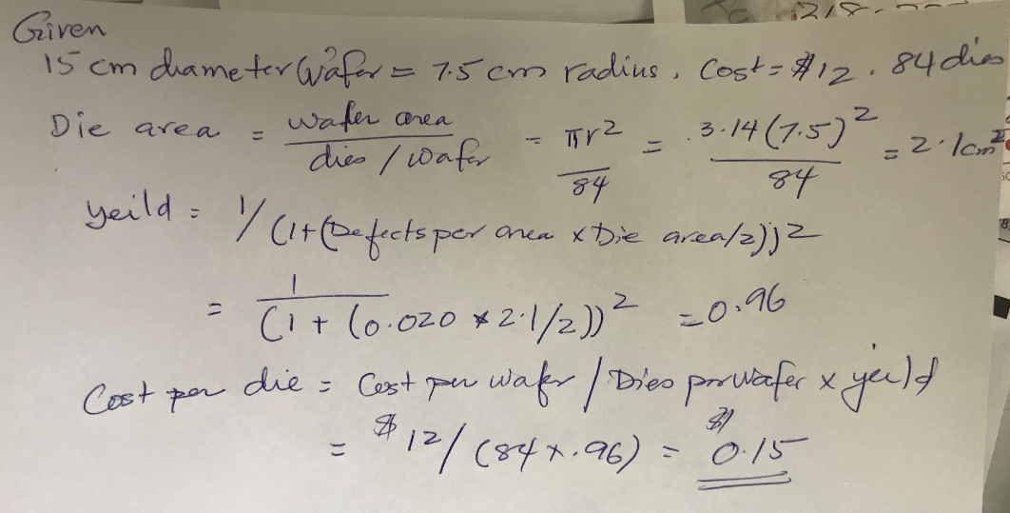
Assume a 15 cm diameter wafer has a cost of 12, contains 84 dies, and has 0.020 defects/cm2. Calculate yield and cost per die.
Prof. John P. Abraham, UTRGV

Slide 71
Measuring, Reporting & Summarizing Performance. 1.8
What criteria do we use to say one computer is faster than another?
We might use terms such as:
  execution time (also called response time)
  Throughput
    number of programs / unit time
  wall-clock time (or elapsed time)
  CPU time, user CPU time, system CPU time
    CPU time = user CPU time + system CPU time
  System performance (on an unloaded system)
  CPU performance
Prof. John P. Abraham, UTRGV

Slide 72
Performance Measures
To say X is n times faster than Y means that
  Execution time Y / Execution time X = n
  Performance X / Performance Y = n
The throughput of X is 1.3 times higher than Y means that the number of tasks that can be executed on X is 1.3 more than on Y in the same amount of time
Prof. John P. Abraham, UTRGV

Slide 73
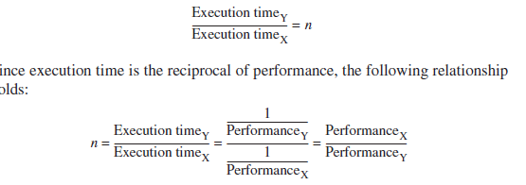
Execution time
Execution time depends upon performance of the machine
  Execution time = 1/performance.
    Better the performance smaller the time
  n= 1/performance of y
  1/performance of x
Prof. John P. Abraham, UTRGV

Slide 74
UNIX time
UNIX time command returns four measurements
  90.7u 12.9s 2:39 65%
cpu time = 90.7 sec
System cpu time = 12.9s
Elapsed time = 2min 39sec
%of cpu time (90.7+12.9) over total time=65%
Prof. John P. Abraham, UTRGV

Slide 75
Evaluating Peformance
There are four levels or programs that can be used to test performance
  Real programs - e.g., C compiler, TeX, CAD tool, programs that have input and output and options that the user can select
  Kernels - remove key pieces of programs and just test those
  Toy benchmarks - 10-100 lines of code such as quicksort whose performance is known in advance
  Synthetic benchmarks - try to match average frequency of operations to simulate those instructions in some large program
Prof. John P. Abraham, UTRGV

Slide 76
Benchmark Suite
A set of programs that test different performance metrics such as arrays, floating point operations, loops, etc…
  SPEC CPU2006is a commonly quoted benchmark suite
    12 integer and 17 floating point benchmarks
  Server Benchmarks – around OpenMP and MPI
    SPECrate
    SPECSFS
Prof. John P. Abraham, UTRGV

Slide 77
Reporting Performance Results
One important factor is that performance results be reproducible -
  However, reported results may omit such information as the input, compiler settings, version of compiler, version of OS, size and number of disks, etc…
  SPEC benchmark reports must include information like compiler flags, fairly complete description of the machine, and results running with normal and optimized compilers Comparing Performances
Prof. John P. Abraham, UTRGV

Slide 78
Quantitative Principles of Computer Design 1.9
Parallelism-pipelining
  most important methods for improving performance
Principle of locality
  –Temporal locality.. tendency to use same code used recently
  -Spatial locality..items whose addresses are near each other tend to be used close together
Focus on Common case – frequent case vs. infrequent case. Example, fetch/decode is more frequently than multiplier
Prof. John P. Abraham, UTRGV

Slide 79
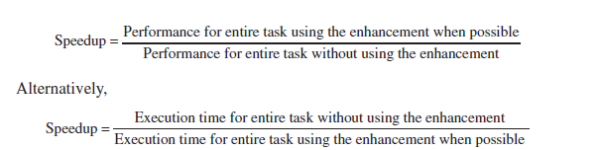
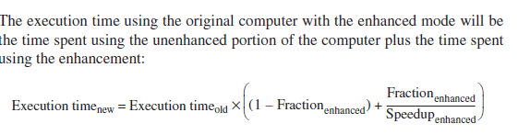
Amdahl’s Law
A fundamental law in describing performance gain created through some architectural improvement as speedup -- “make the common case fast”
Prof. John P. Abraham, UTRGV

Slide 80
Using Amdahl’s Law
We must consider two factors in using this:
  Fraction of the computation time in the original machine that can be converted to take advantage of the enhancement
  Improvement gained by the enhanced execution mode (how much faster will the task run if the enhanced mode is used for the entire program?)
Speedup = 1 / [ (1 - fraction enhanced) + Fraction enhanced / Speedup enhanced) ]
Prof. John P. Abraham, UTRGV

Slide 81
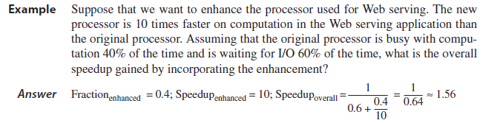
Examples
  An enhancement runs 10 times faster but is only usable 40% of the time.
    Speedup = 1 / [(1 - .4) * .4/10] = 1.56
Prof. John P. Abraham, UTRGV

Slide 82
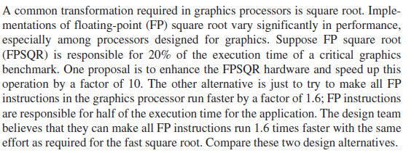
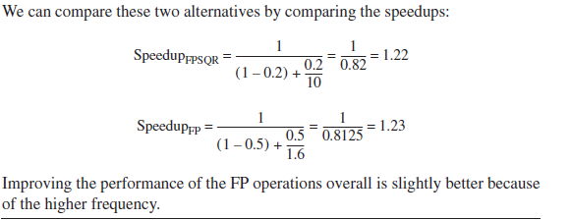
Suppose FP sqrt is responsible for 20% of instructions in a benchmark
Prof. John P. Abraham, UTRGV

Slide 83
The Processor Performance Equation
Essentially all computers are constructed using a clock running at a constant rate.
These discrete time events are called ticks, clock ticks, clock periods, clocks,
Prof. John P. Abraham, UTRGV

Slide 84
CPU Performance
  CPU time = CPU clock cycles * clock cycle time
  CPU time = CPU clock cycles for prog / Clock rate
  IC - instruction count
    This is the # of instructions in the program
  CPI - clock cycles per instruction
  CPI = CPU clock cycles for prog / IC
  CPU time = IC * CPI * Clock cycle time
  CPU time = (Sum CPI_{i} * IC_{i}) * clock cycle time
  Average CPI = Sum (CPI_{i} * IC_{i}/ Instruction Count)
Prof. John P. Abraham, UTRGV

Slide 85
Example
  Frequency of FP operations = 25%
  Average CPI of FP operations = 4.0
  Average CPI of other instructions = 1.33
  Frequency of FP sqrt = 2%
  CPI of FP sqrt = 20
  CPI = 4*25%+1.33*75% = 2.0
Two alternatives: reduce CPI of FP sqrt to 2 or reduce CPI of all FP ops to 2
  CPI new FP sqrt = CPI original - 2% * (20-2) = 1.64
  CPI new FP = 75%*1.33+25%*2.0=1.5
  Speedup new FP = CPI original/CPI new FP = 1.33
    refer back to previous example
Prof. John P. Abraham, UTRGV

Slide 86
CPU Components’ Performance
Large part of a Comp. Architect’s job is to design tools or means of measuring the CPU component performances
  Low level tools: timing estimators
We can also measure the instruction count for a program using compiler technology, using the program execution duration and the instruction mix
Execution-based monitoring by including in the program, code that saves the instruction mix during execution
Prof. John P. Abraham, UTRGV

Slide 87
Measuring CPI
Requires knowing the processor’s organization and the instruction stream
  Designers may use Average CPIs but this is influenced by cache and pipeline structures
  We might assume a perfect memory system that does not cause delays
  Pipeline CPI measures can be determined by simulating the pipeline
    This might be sufficient for simple pipes but not for advanced pipes
Prof. John P. Abraham, UTRGV

Slide 88
More Ex’s of CPU Performance
2 alternatives for a conditional branch instruction
  CPU A: condition code is set by a compare instruction and followed by a branch that tests the condition code
  CPU B: compare is included in the branch
Conditional branch takes 2 cycles, all other instructions take 1 clock cycle
For CPU A, 20% of all instructions are conditional branches
Assume CPU A has a clock cycle time 1.25 times faster than CPU B
  since CPUA does not have the compare included in the branch statement
Which CPU is faster?
Prof. John P. Abraham, UTRGV

Slide 89
Solution
CPI A = .2 * 2 + .8 * 1 = 1.2
CPU time A = IC A * 1.2 * Clock Cycle time A
  A’s clock rate is 1.25 times higher than B
  Compares are not executed in isolation on B, so there are instead 25% compares and 75% other
CPI B = .25 * 2 + .75 * 1 = 1.25
CPU time B = IC B * 1.25 * Clock Cycle time B = .8 * IC A * 1.25 * 1.25 * Clock Cycle time A
CPU time B = 1.25 * IC A * Clock Cycle time A
So, CPU time A is shorter than B and so A is faster
Prof. John P. Abraham, UTRGV

Slide 90
What if A’s clock cycle = 1.1 B?
We repeat the previous solution changing
  Clock Cycle time A = 1.1 * Clock Cycle time B
    instead of using 1.25
  CPU time A = 1.2 * IC A * Clock Cycle time A
  CPU time B = IC B * 1.25 * Clock Cycle time B = .8 * IC A * 1.25 * 1.1 Clock Cycle time A = 1.1 * IC A * Clock Cycle time A
  So, in this case, CPU B is faster
Prof. John P. Abraham, UTRGV

Slide 91
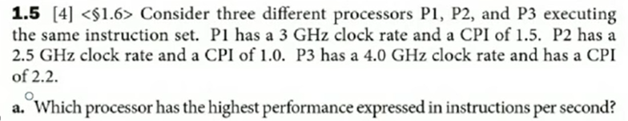
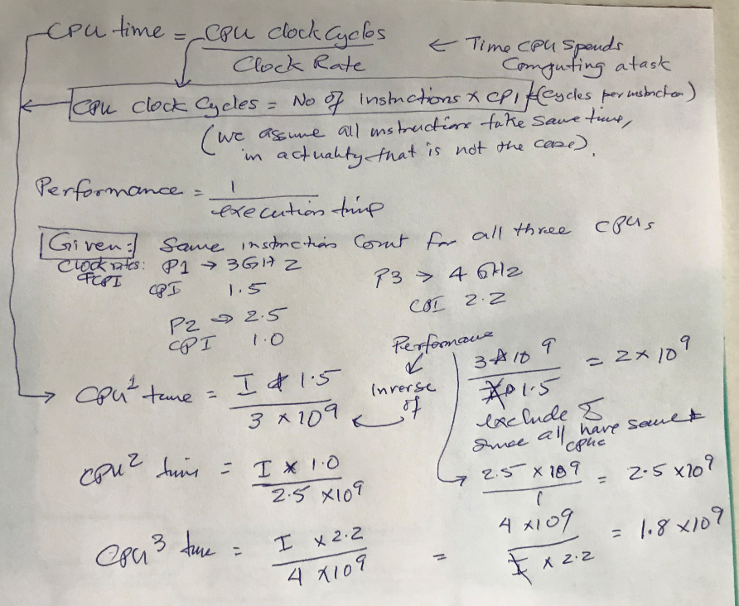
Prof. John P. Abraham, UTRGV

Slide 92
Memory Hierarchy
Register (CPU)
Cache
Main Memory
I/O Devices
  Hard Disk
  Optical disk, floppy disk
  Magnetic tape
Prof. John P. Abraham, UTRGV

Slide 93
Cache Performance
Assume: Cache is 10 times faster than memory and cache hit rate is 90%
How much speedup is gained using this cache?
  Use Amdahl’s law:
  Speedup = 1 / [(1-90%) + (90%/10)] = 1/[.1+.9/10] = 5.3
Over a 5 times speedup by using cache with these specifications!
Prof. John P. Abraham, UTRGV

Slide 94
Memory Impact on CPU
In a pipeline, a memory stall will occur if the memory fetch of an operand is not found in cache
  CPU execution time = (CPU clock cycles + Memory stall cycles) * Clock cycle
  Memory stall cycles = number of misses * miss penalty = IC * misses per instruction * miss penalty = IC * mem ref’s/instr * miss rate * miss penalty
  Miss rate is determined by cache efficiency
  Miss penalty is determined by main memory system speed (also bus load and bandwidth, etc…)
Prof. John P. Abraham, UTRGV

Slide 95
Example
Assume a machine with
  CPI = 2.0 when all memory accesses are hits
  Only data accesses are loads and stores (40% of all instructions are loads and stores)
  Miss penalty = 25 clock cycles
  Miss rate = 2%
  How much faster would the machine be if all accesses are hits?
Prof. John P. Abraham, UTRGV

Slide 96
Solution
For machine with no misses:
  CPU exec. Time = (CPU clock cycles + memory stall cycles) * clock cycle = (IC * CPI + 0) * clock cycle
For machine with 2% miss rate:
  Memory stall cycles = IC * memory references/instr * miss rate * miss penalty = IC * (1 + .4) * .02 * 25 = IC * .7
  CPU exec Time = (IC * 2.0 + IC * .7) * clock cycle = 2.7 * IC * clock cycle
So, the machine with no misses is 2.7/2.0 times faster or 1.35 times faster
Prof. John P. Abraham, UTRGV

